Slide 1

SR Latch Project
Project by:
Mohannad Wael Taman 19100213 Mohammed Nasser El-Maghraby 19102722
Class C

Slide 2

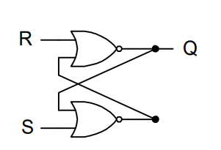
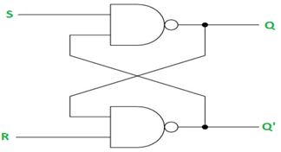
The SR-latch is shown below utilizing 2-NOR gates with a cross loop connection.
These latches can be built with NAND gates also;

Slide 3
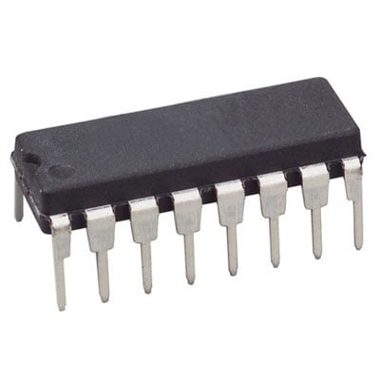
A latch is a type of logic circuit in digital electronics that is also known as a bistable-multivibrator. Because it can exist in two stable states: active high and active low. It functions as a storage device by storing data in a feedback lane. As long as the Power device is turned on, it stores one piece of data. When enable is declared, latch can modify the stored data immediately.
An SR latch (Set/Reset) is an asynchronous device: it works independently of control signals and relies only on the state of the S and R inputs, Therefore it doesn’t depend on the CLK it changes its whenather there is a change in The SR inputs

Slide 4
When the S-line of the latch receives a high input, the output Q also becomes high. When the S-input becomes low again in the feedback process, the output Q will remain high. The latch functions as a memory device in this fashion.
Q will always have the value as S
Qbar will always have the value of the R
In case you didn’t Set or Reset ( 0 and 0 ) Q and Qbar will remain unchanged “Memory”
Case of both Set and Reset are both high is an invalid case as it is only allowed to Set or Reset at once
Because when both inputs are high at the same time, there's a problem: it's being commanded to generate a high Q and a low Q at the same time. This creates a race condition in the circuit since whichever flip flop changes first will respond to the other and announce itself. Both logic gates should be equal, and the gadget should be in an indeterminate state for an extended period of time.

Slide 5
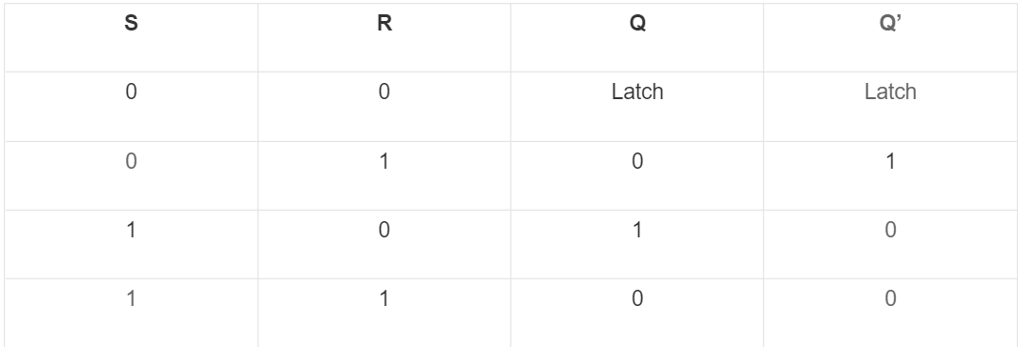
Truth Table for SR latch:

Slide 6
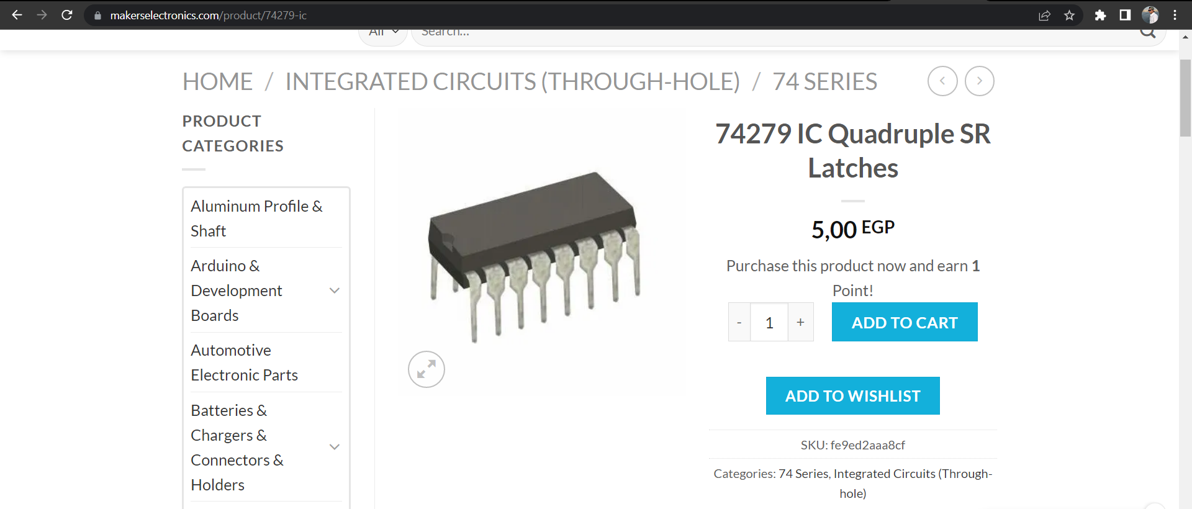
Market Value in Egypt

Slide 7

SIMULATION

Slide 8
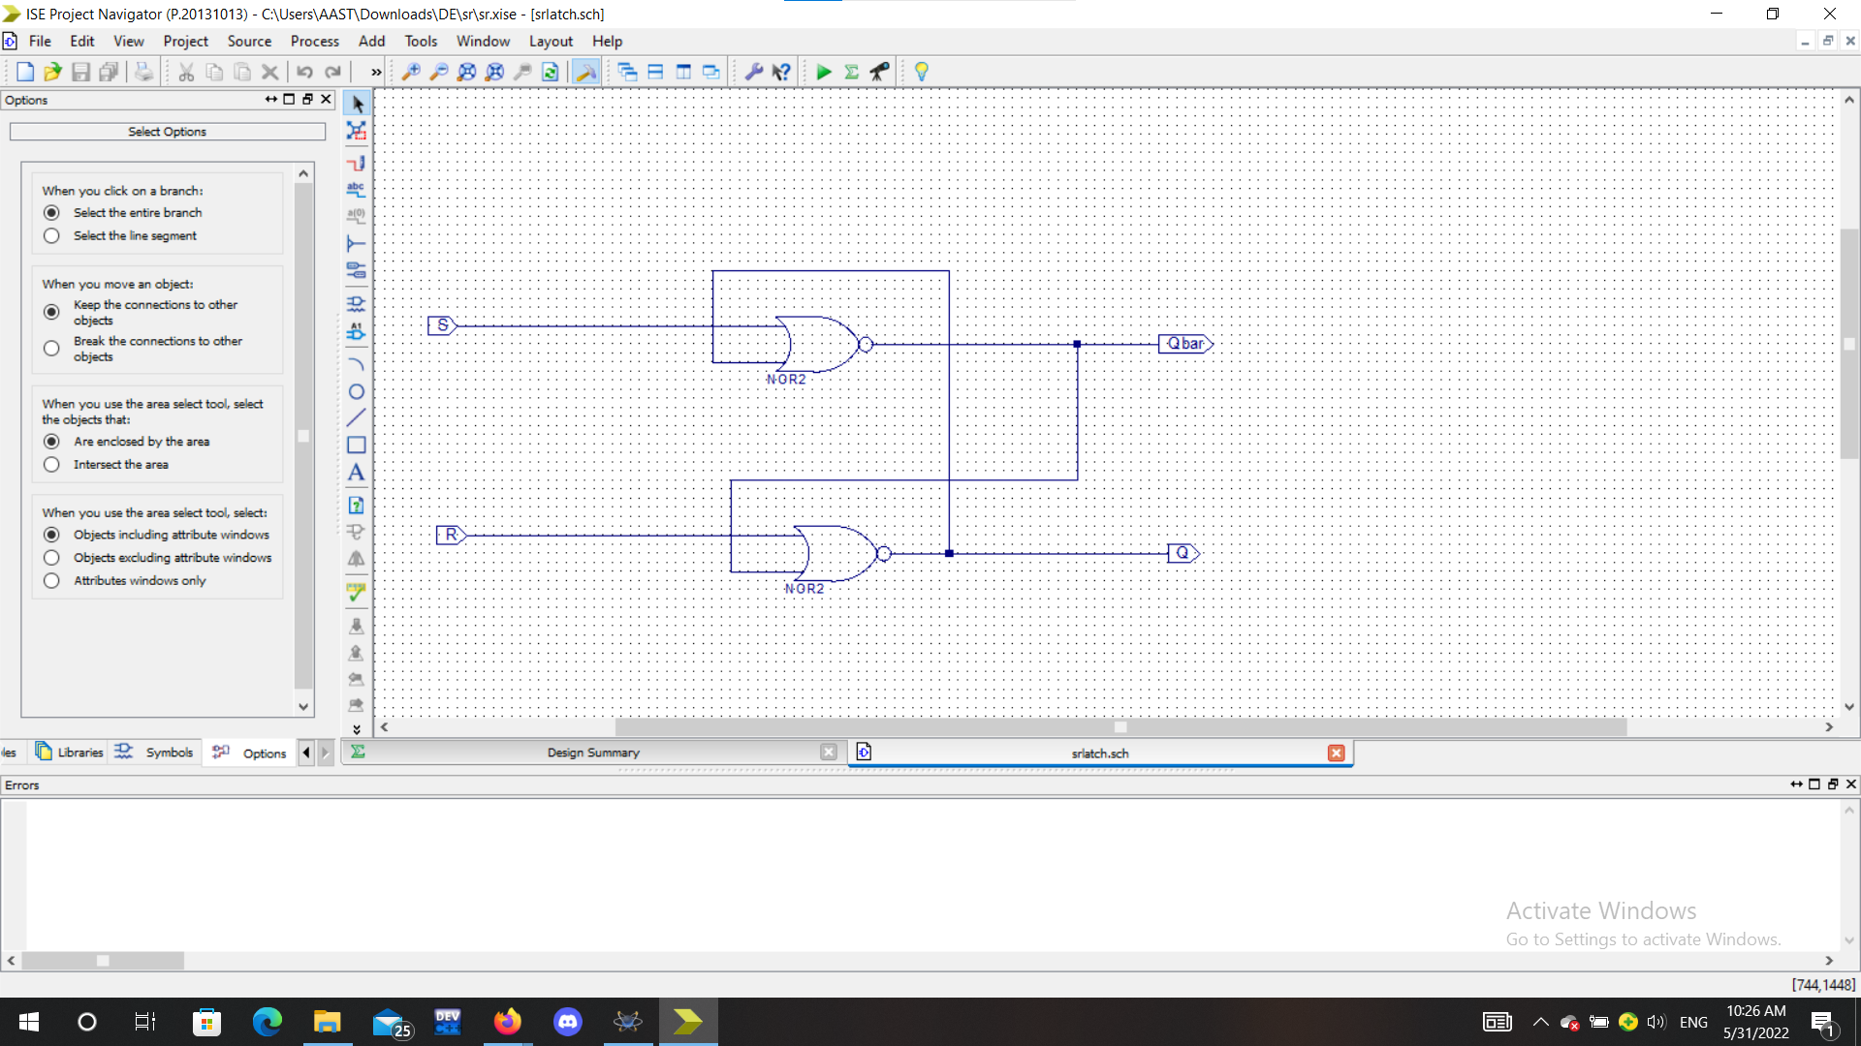

Slide 9
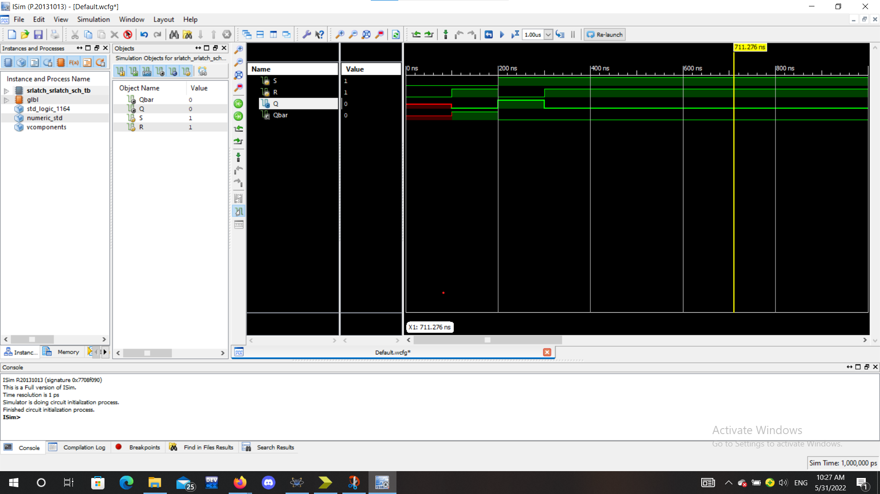

Slide 10
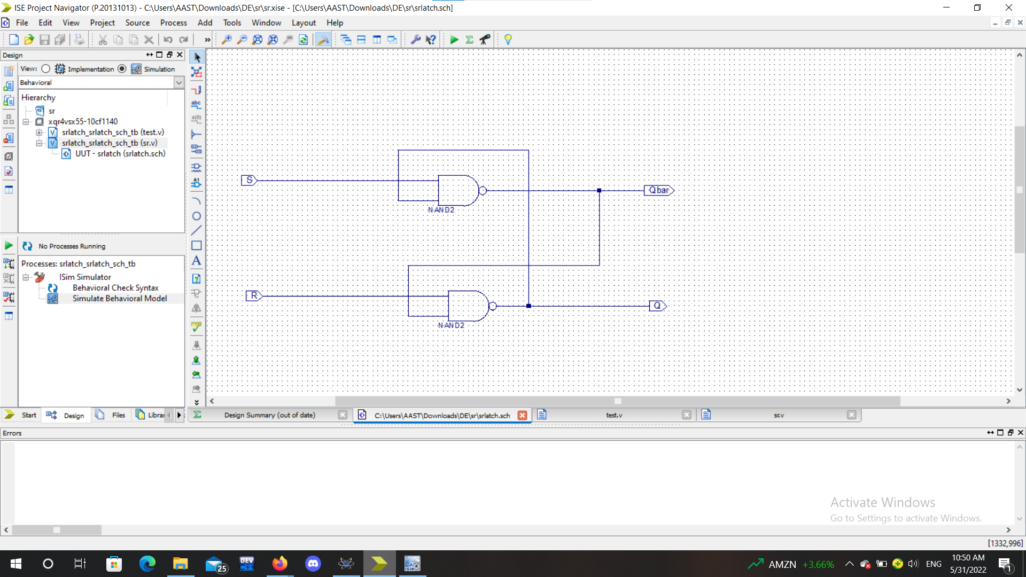

Slide 11
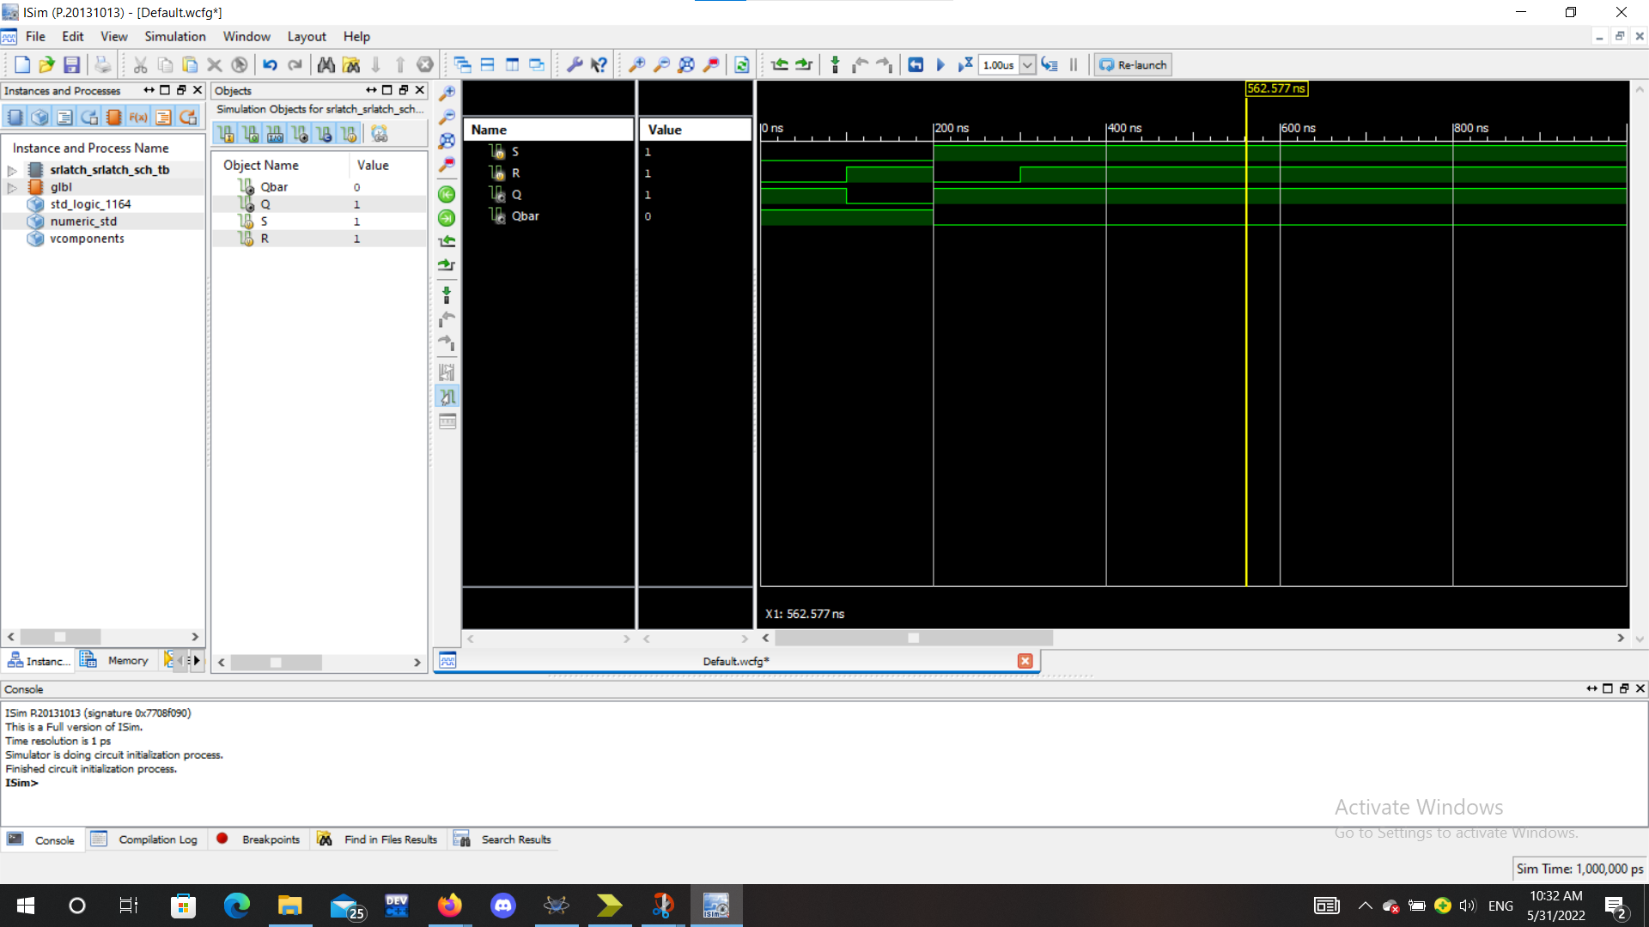

Slide 12
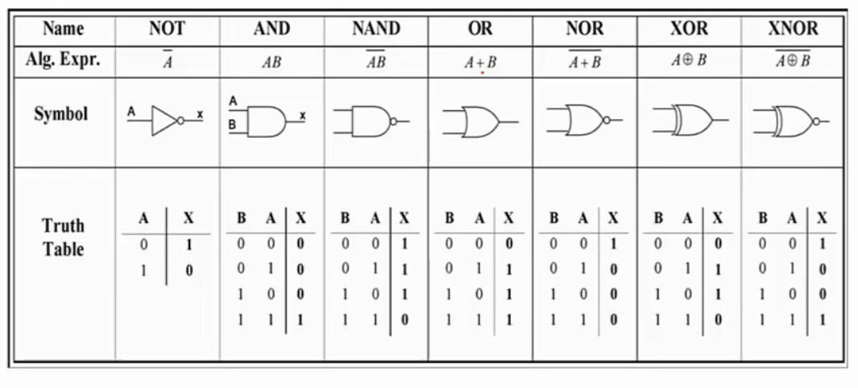
SR Latches can be implemented in various ways as mentioned above
Not only SR Latches that can be implemented in various ways, but alos Logic Gates can be implements using different components and methods, each with its own advantages and disadvantages

Slide 13
In SR latch we only need to learn about 2 Logic Gates Which are NOR and NAND
We can implement both using various methods such as:
DL
RTL
DTL
TTL
NMOS
PMOS
CMOS
ECL
I2L

Slide 14

POSTER:

Slide 15
SIMULATION

Slide 16

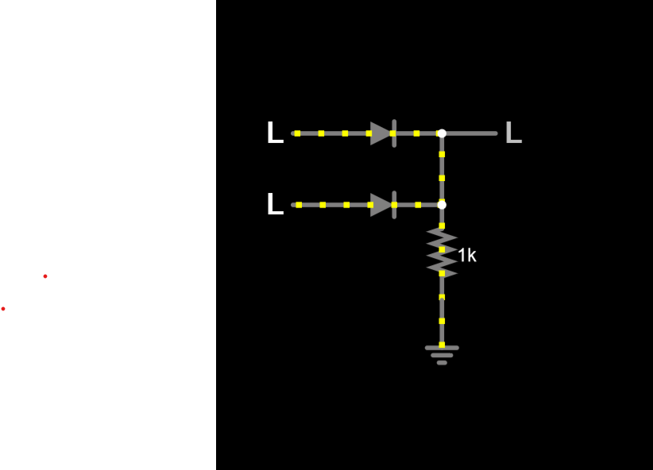
SR latch using DTL
Simulation of OR gate using DTL
Case :
V1 LOW
V2 LOW
OUTPUT LOW

Slide 17
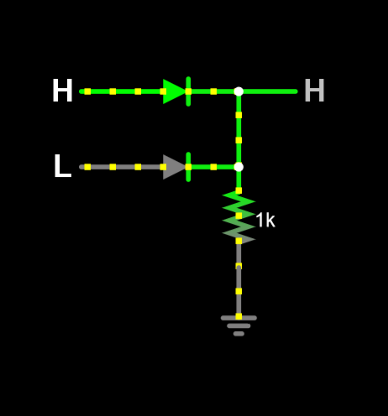
Case :
V1 HIGH
V2 LOW
OUTPUT HIGH

Slide 18
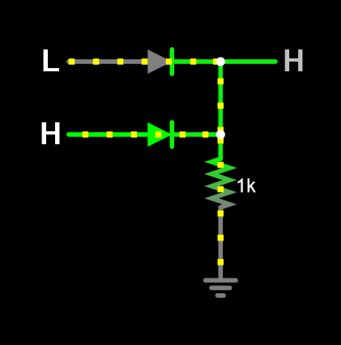
Case :
V1 LOW
V2 HIGH
OUTPUT HIGH

Slide 19
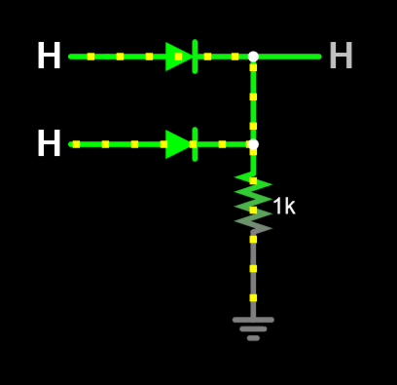
Case :
V1 HIGH
V2 HIGH
OUTPUT HIGH

Slide 20
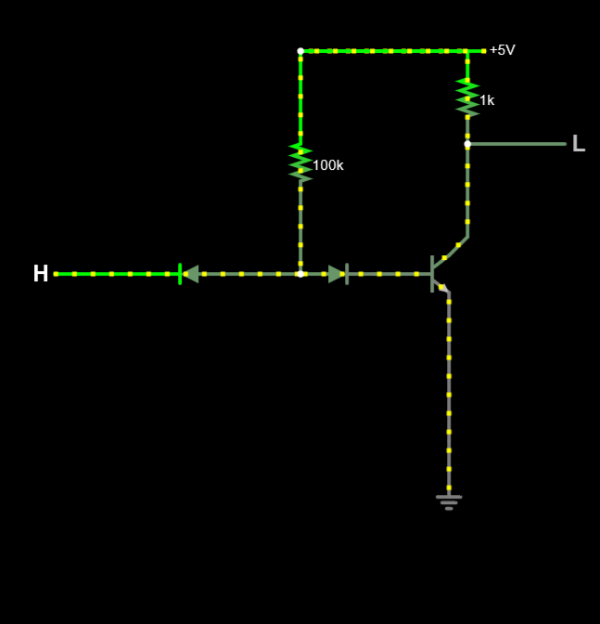
NOT GATE using DTL:
Case :
V1 HIGH
OUTPUT LOW

Slide 21
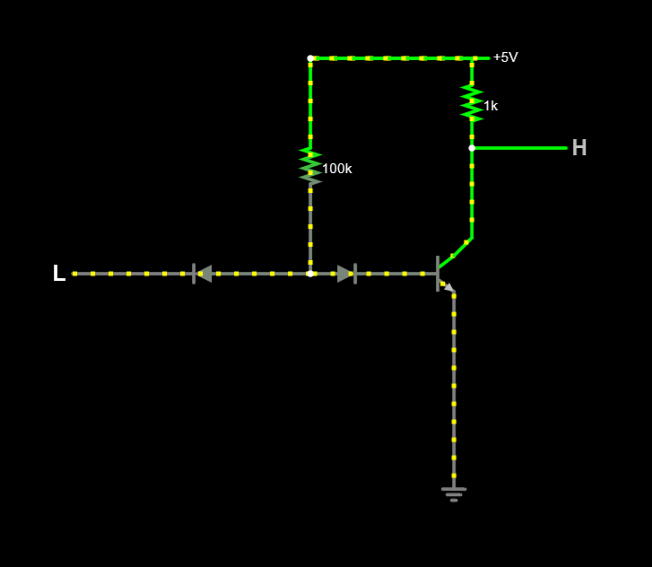
Case :
V1 LOW
OUTPUT HIGH

Slide 22
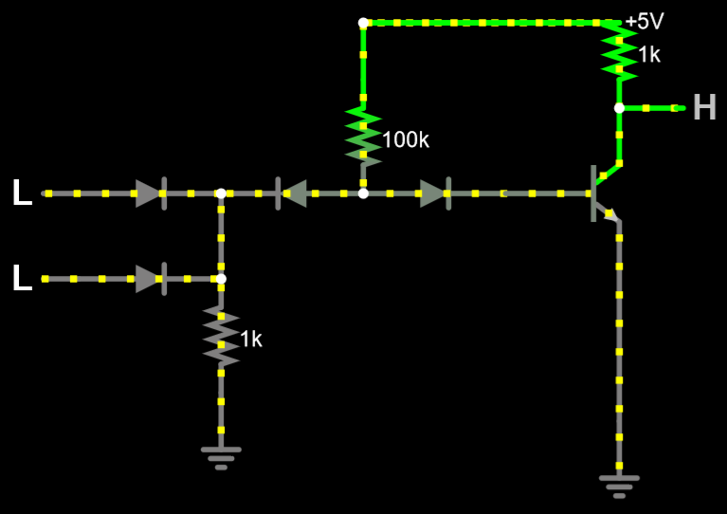
NOR GATE using DTL
Case :
V1 LOW
V2 LOW
OUTPUT HIGH

Slide 23
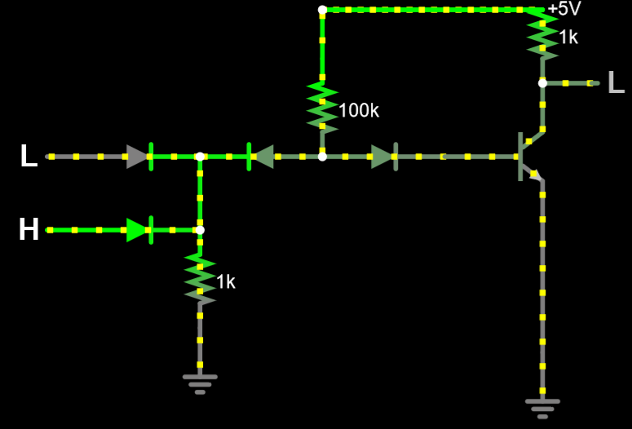
Case :
V1 LOW
V2 HIGH
OUTPUT LOW

Slide 24
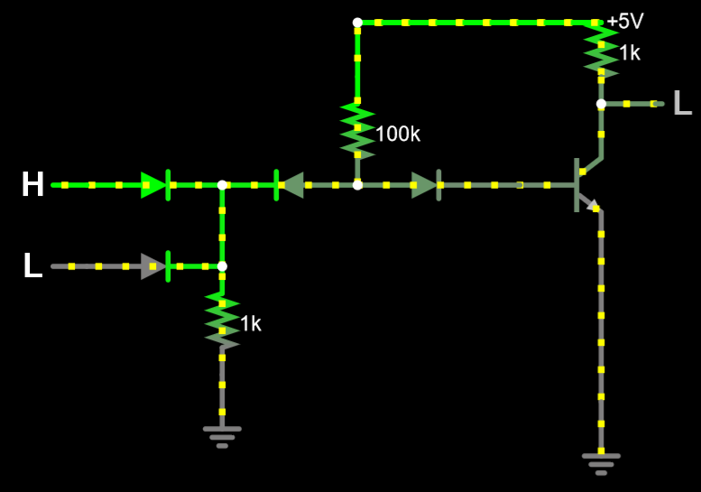
Case :
V1 HIGH
V2 LOW
OUTPUT LOW

Slide 25
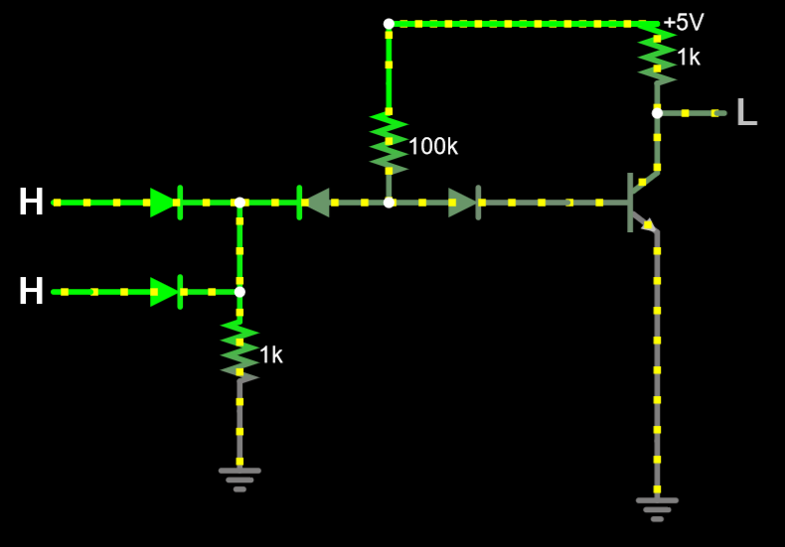
Case :
V1 HIGH
V2 HIGH
OUTPUT LOW

Slide 26
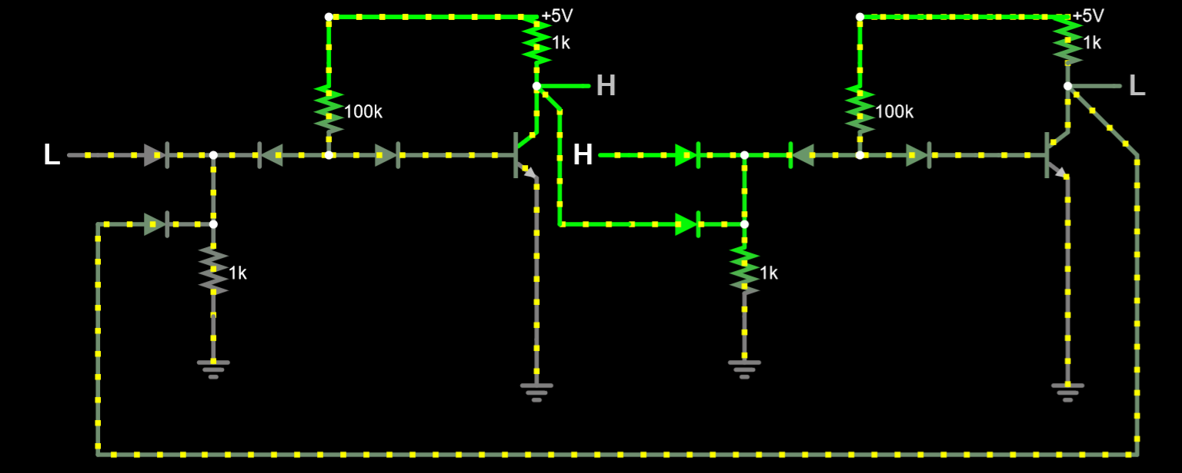
SR Latch using DTL:
Case :
V1 LOW
V2 HIGH
OUTPUT1 HIGH
OUTPUT2 LOW

Slide 27
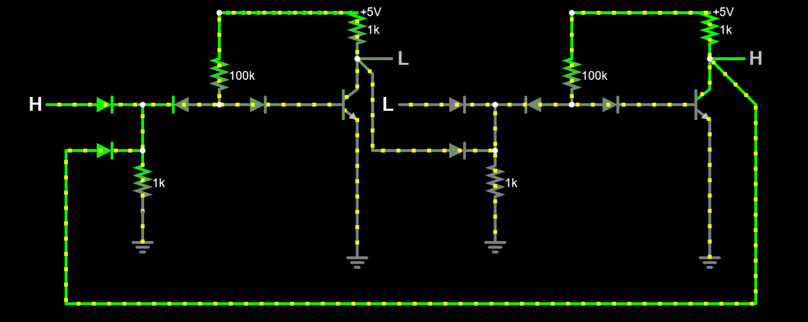
Case :
V1 HIGH
V2 LOW
OUTPUT1 LOW
OUTPUT2 HIGH

Slide 28
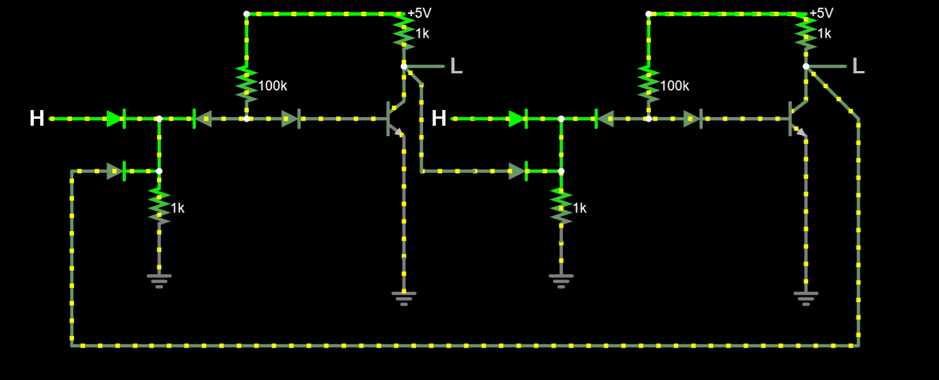
Case :
V1 HIGH
V2 HIGH
OUTPUT1 LOW
OUTPUT2 LOW

Slide 29
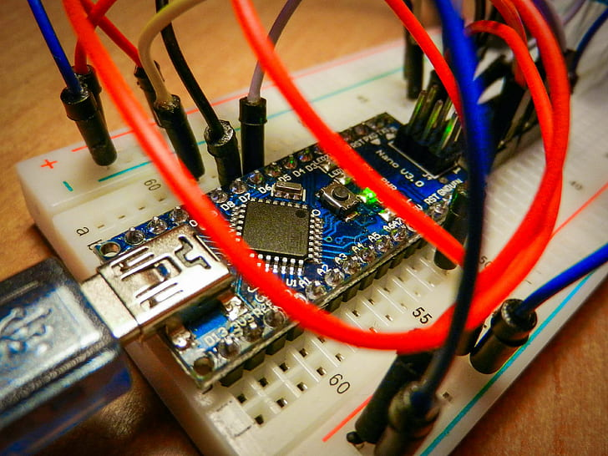
BreadBoard

Slide 30
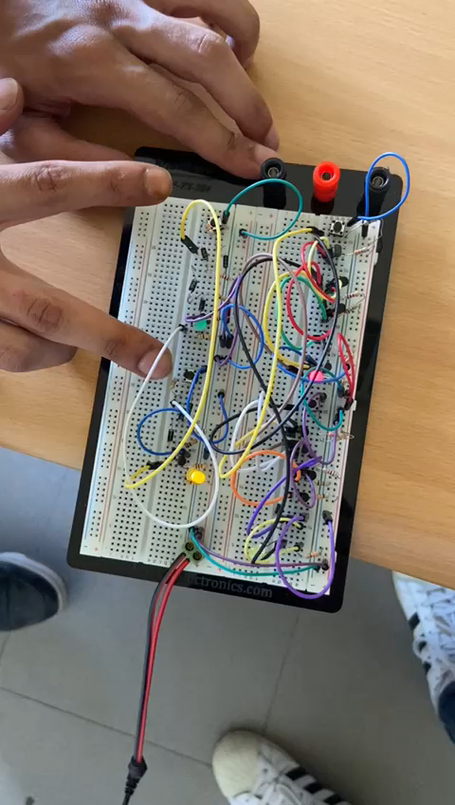

Slide 31

COST ANAYSIS

Slide 32
Diode 1N4007 1A = 3.5
Wires = 9
Resistance = 3
Transistor 2N2222 =1.5
 | SOLUTION A | SOLUTION B | SOLUTION C
TOTAL COSTS | 68 | 76 | 500
TOTAL BENIFITS | 432 | 424 | 0
COST BENEFIT RATIO | 6.35 | 5.57 | 0
Solution B uses more nodes on breadboard, hence more wires
Solution C is buying a ready SR Latch IC

Slide 33
SIMULATION

Slide 34
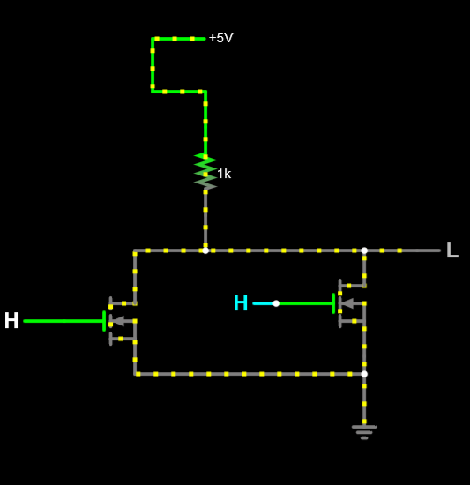
SR Latch using NMOS
NOR Gate using NMOS:
Case :
V1 HIGH
V2 HIGH
OUTPUT LOW

Slide 35
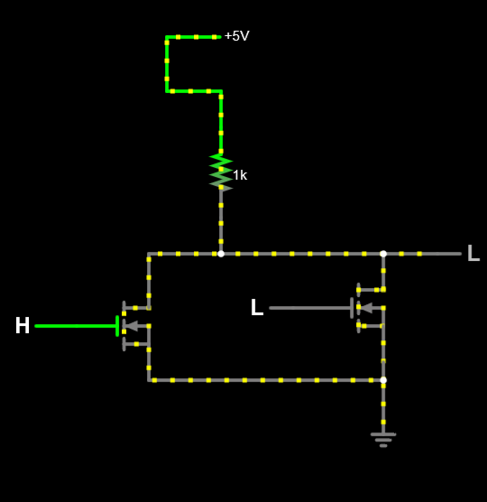
Case :
V1 HIGH
V2 LOW
OUTPUT LOW

Slide 36
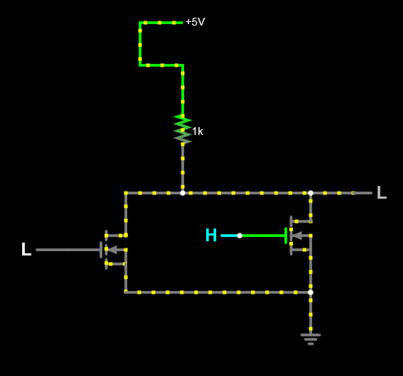
Case :
V1 LOW
V2 HIGH
OUTPUT LOW

Slide 37
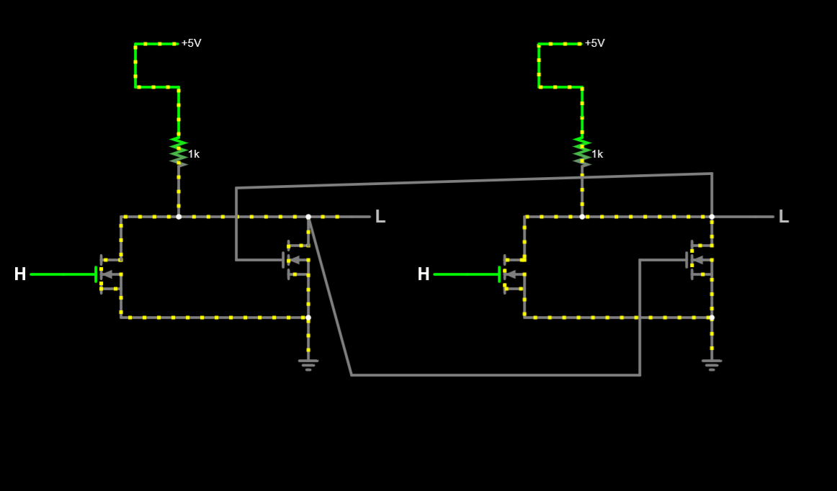
SR Latch using NMOS:
Case :
V1 HIGH
V2 HIGH
OUTPUT LOW “ INVALID “

Slide 38
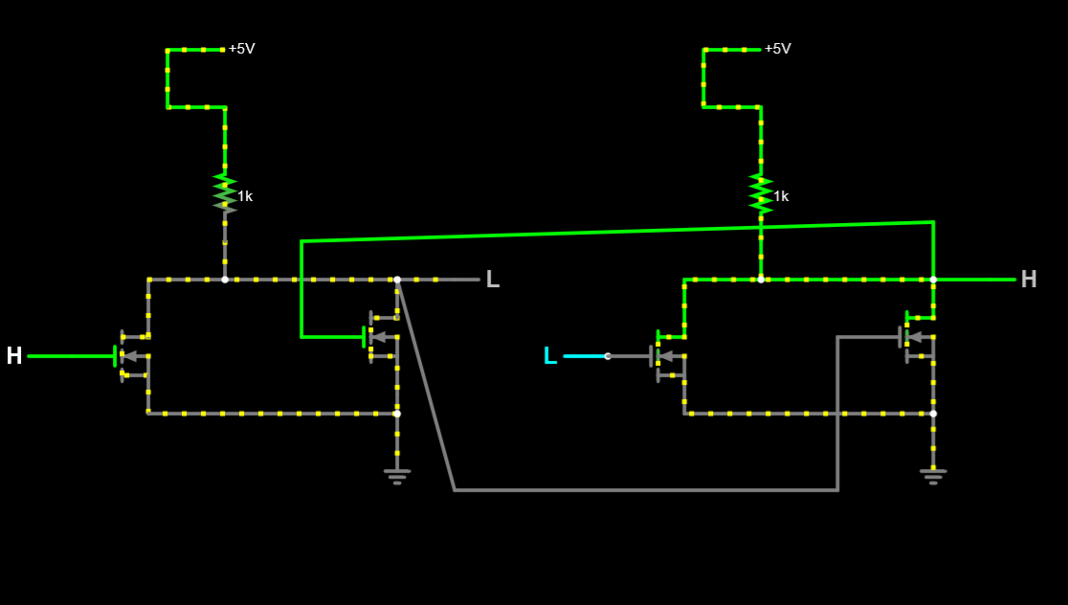
Case :
V1 HIGH
V2 LOW
OUTPUT1 LOW
OUTPUT2 HIGH

Slide 39
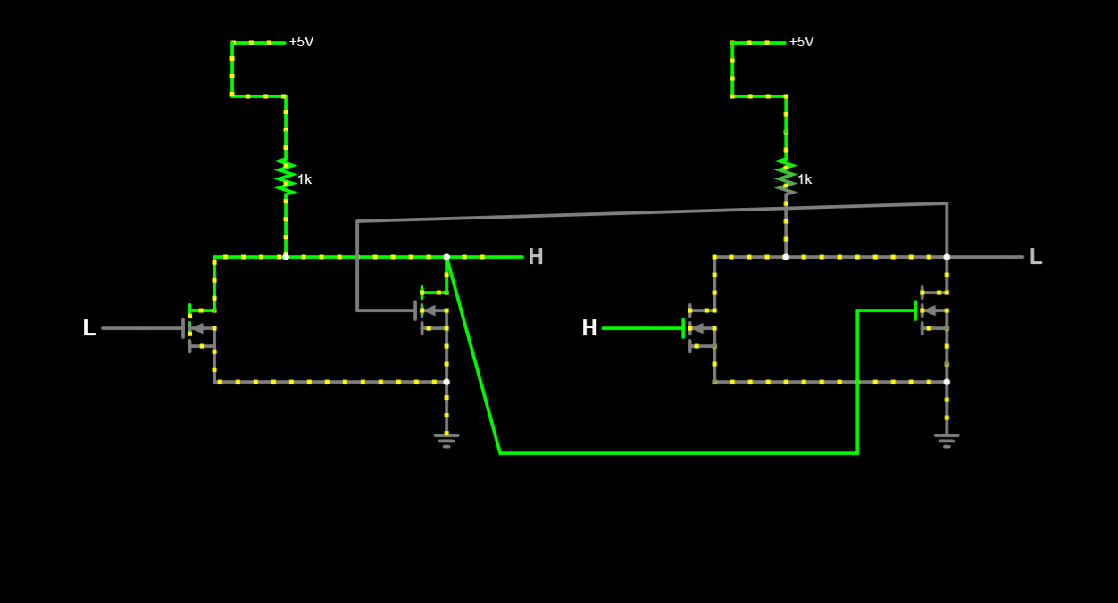
Case :
V1 LOW
V2 HIGH
OUTPUT1 HIGH
OUTPUT2 LOW

Slide 40
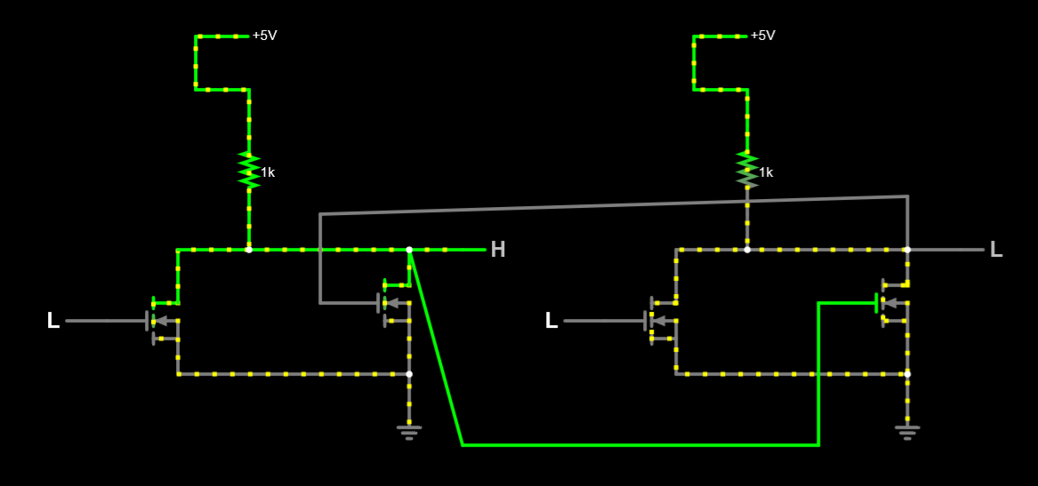
Case :
V1 LOW
V2 LOW
OUTPUT1 HIGH
OUTPUT2 LOW

Slide 41
BreadBoard

Slide 42
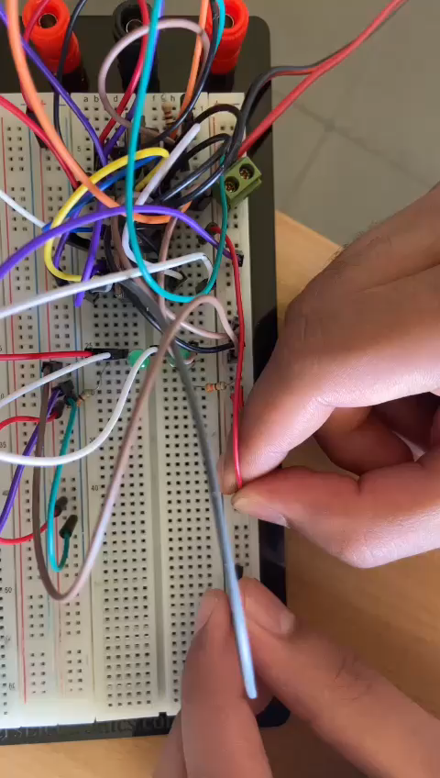

Slide 43
COST ANAYSIS

Slide 44
Wires = 13
Resistance = 3
Transistor IRF9530 = 39
 | SOLUTION A | SOLUTION B | SOLUTION C
TOTAL COSTS
TOTAL BENIFITS
COST BENEFIT RATIO
 | SOLUTION A | SOLUTION B | SOLUTION C
TOTAL COSTS | 55 | 59 | 500
TOTAL BENIFITS | 445 | 441 | 0
COST BENEFIT RATIO | 6.35 | 7.47 | 0
Solution B uses more nodes on breadboard, hence more wires
Solution C is buying a ready SR Latch IC

Slide 45
SIMULATION

Slide 46
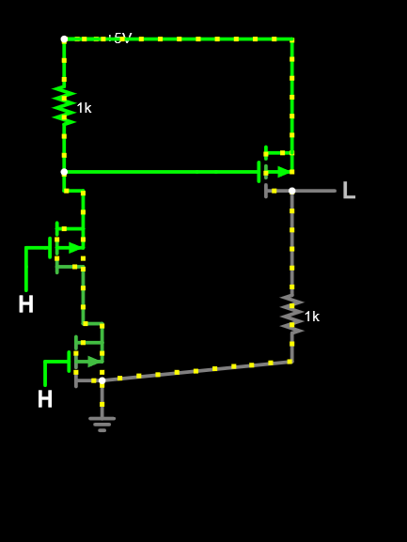
SR Latch using PMOS
Nor using PMOS:
Case :
V1 HIGH
V2 HIGH
OUTPUT LOW

Slide 47
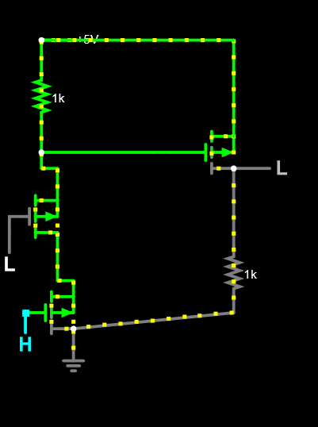
Case :
V1 LOW
V2 HIGH
OUTPUT LOW

Slide 48
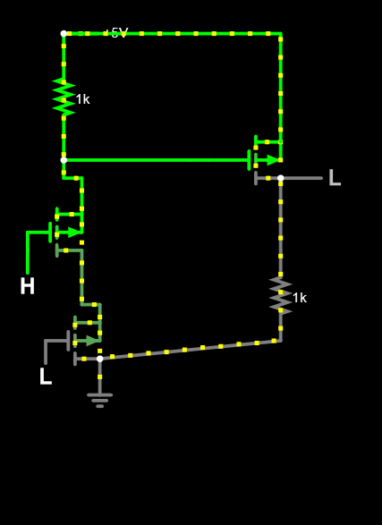
Case :
V1 HIGH
V2 LOW
OUTPUT LOW

Slide 49
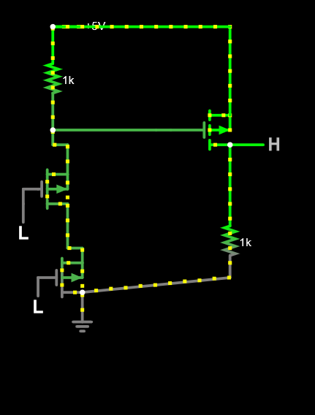
Case :
V1 LOW
V2 LOW
OUTPUT HIGH

Slide 50
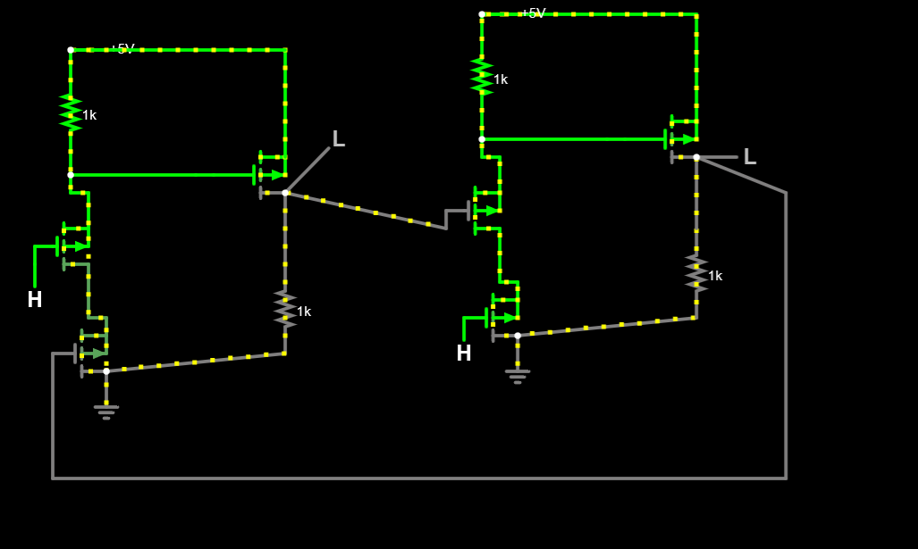
SR Latch using PMOS:
Case :
V1 HIGH
V2 HIGH
OUTPUT1 LOW
OUTPUT2 LOW

Slide 51
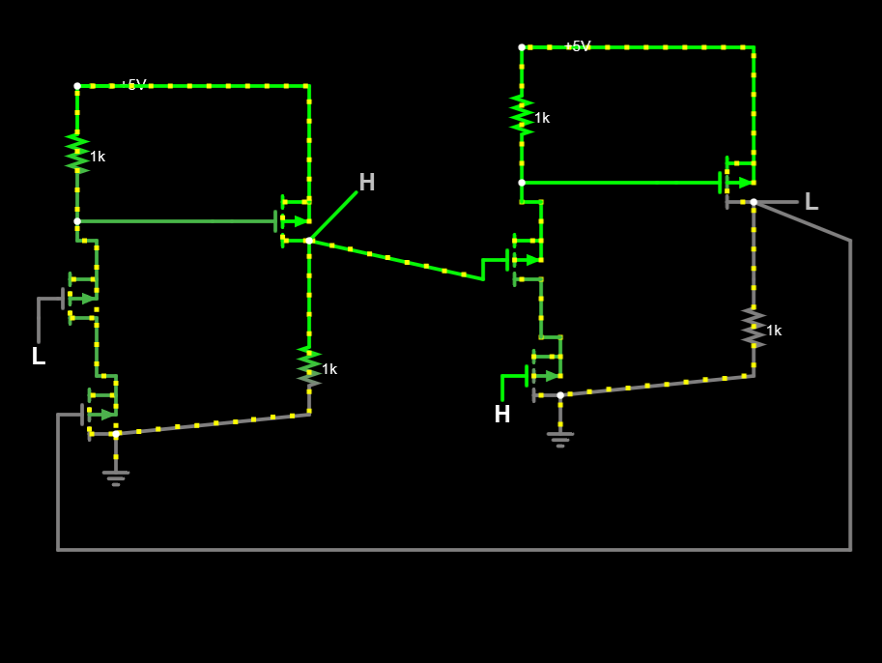
Case :
V1 LOW
V2 HIGH
OUTPUT1 HIGH
OUTPUT2 LOW

Slide 52
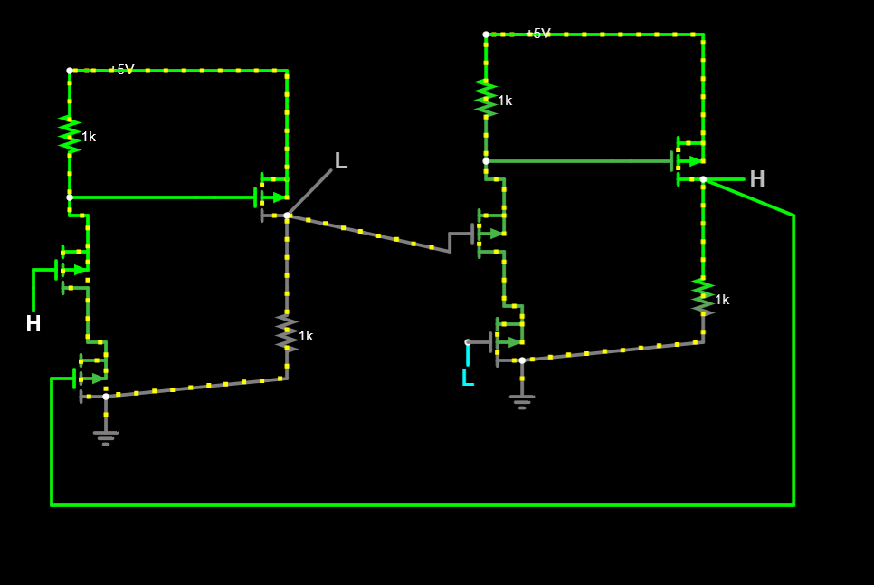
Case :
V1 HIGH
V2 LOW
OUTPUT1 LOW
OUTPUT2 HIGH

Slide 53
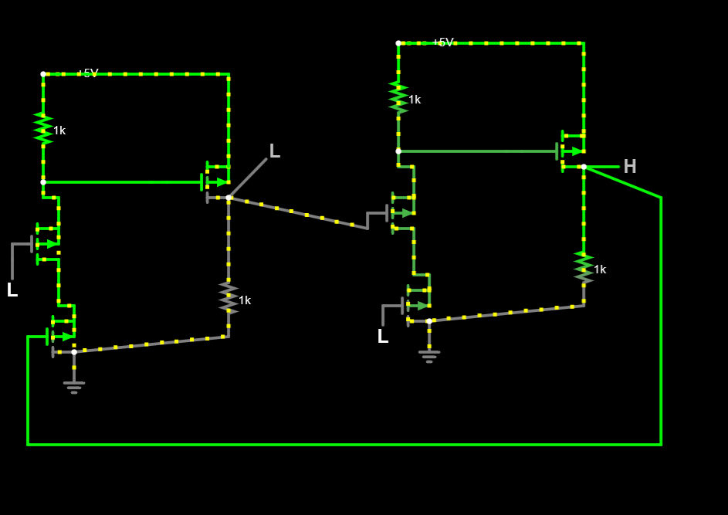
Case :
V1 LOW
V2 LOW
OUTPUT1 LOW
OUTPUT2 HIGH

Slide 54

BreadBoard

Slide 55
COST ANAYSIS

Slide 56
Wires = 13
Resistance = 3
Transistor IRF9540 = 54
 | SOLUTION A | SOLUTION B | SOLUTION C
TOTAL COSTS
TOTAL BENIFITS
COST BENEFIT RATIO
 | SOLUTION A | SOLUTION B | SOLUTION C
TOTAL COSTS
TOTAL BENIFITS
COST BENEFIT RATIO
 | SOLUTION A | SOLUTION B | SOLUTION C
TOTAL COSTS | 70 | 73 | 500
TOTAL BENIFITS | 430 | 497 | 0
COST BENEFIT RATIO | 6.14 | 6.8 | 0
Solution B uses more nodes on breadboard, hence more wires
Solution C is buying a ready SR Latch IC

Slide 57
SIMULATION

Slide 58
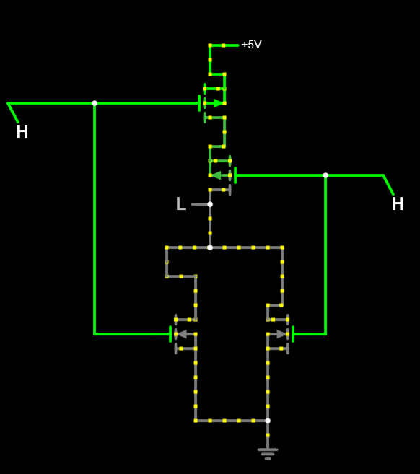
SR Latch Using CMOS
NOR GATE using CMOS:
Case :
V1 HIGH
V2 HIGH
OUTPUT LOW

Slide 59
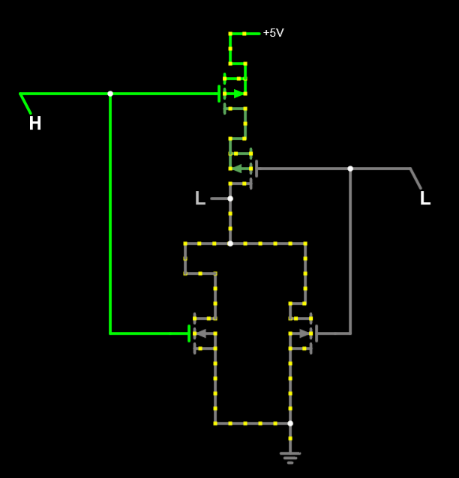
Case :
V1 HIGH
V2 LOW
OUTPUT LOW

Slide 60
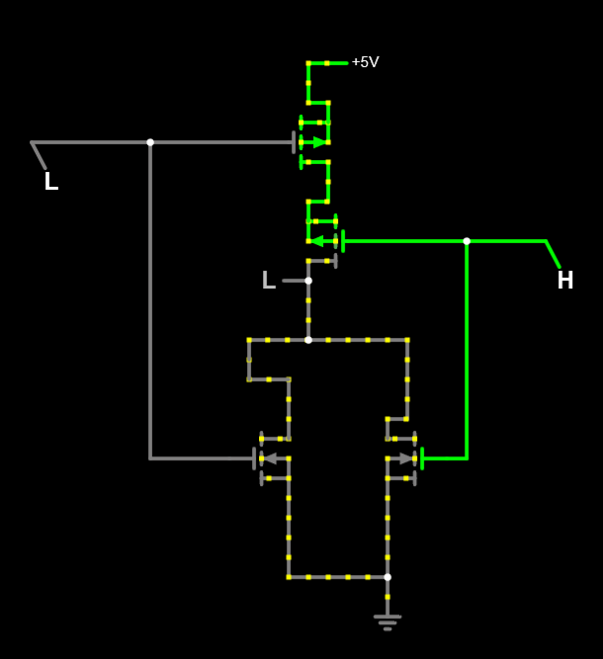
Case :
V1 LOW
V2 HIGH
OUTPUT LOW

Slide 61
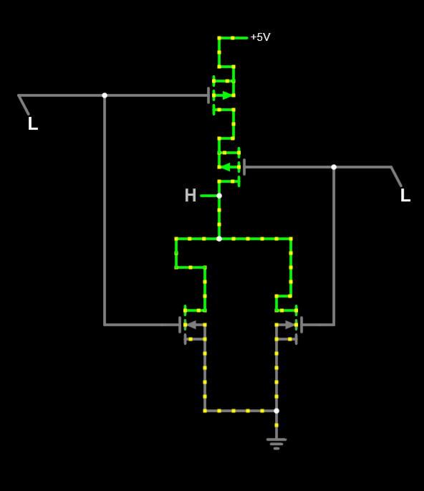
Case :
V1 LOW
V2 LOW
OUTPUT HIGH

Slide 62
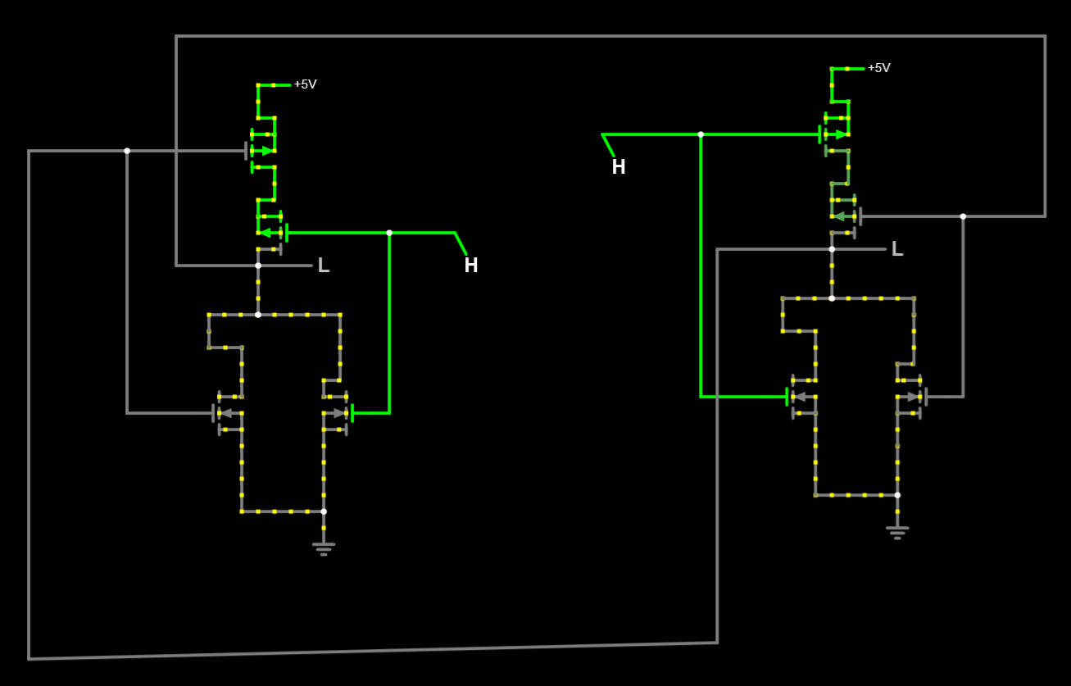
SR LATCH USING CMOS:
Case :
V1 HIGH
V2 HIGH
OUTPUT1 LOW
OUTPUT2 LOW

Slide 63
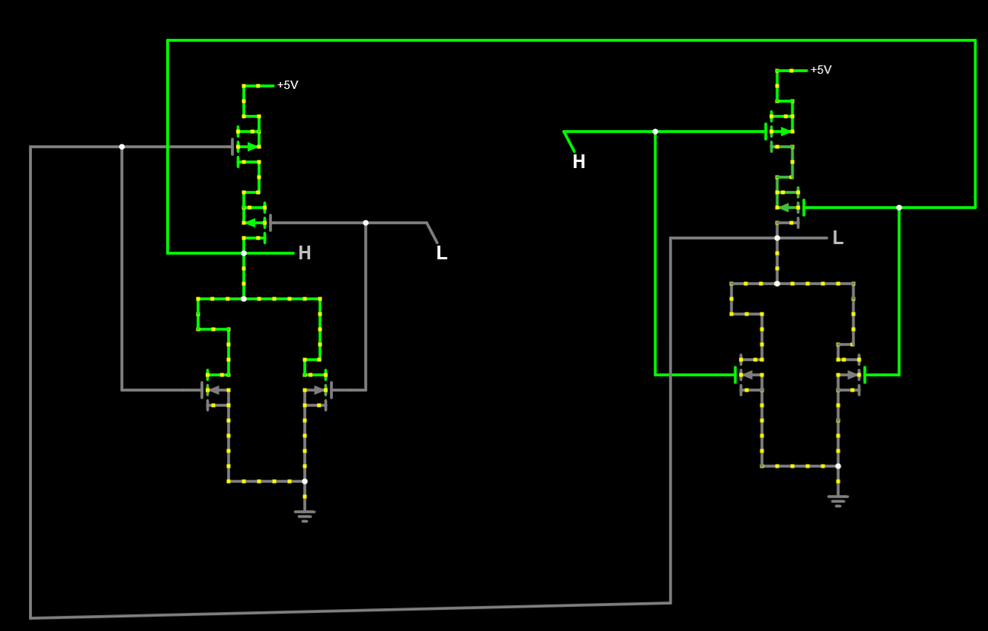
Case :
V1 HIGH
V2 LOW
OUTPUT1 LOW
OUTPUT2 LOW

Slide 64
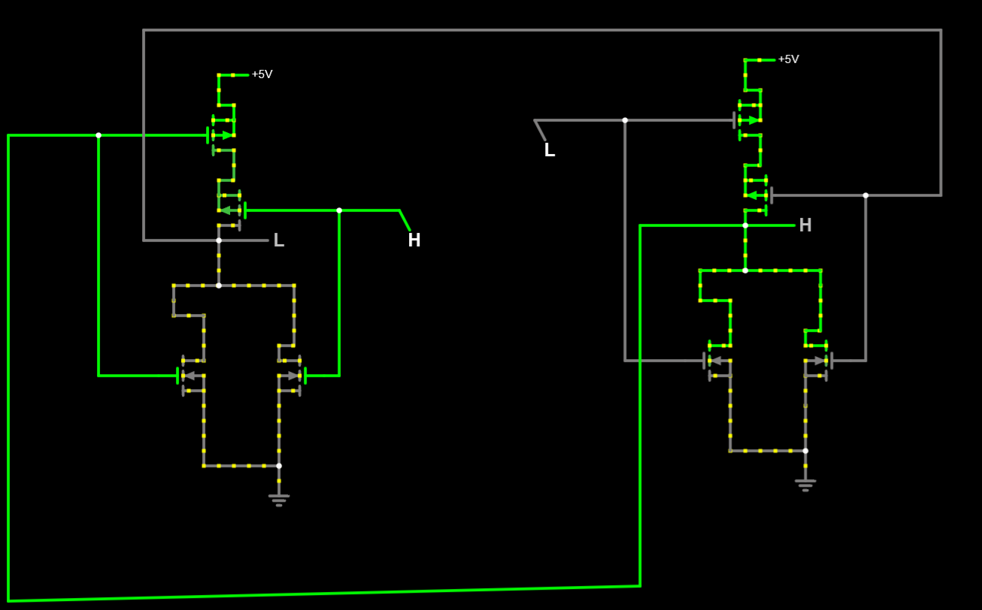
Case :
V1 LOW
V2 HIGH
OUTPUT1 LOW
OUTPUT2 LOW

Slide 65
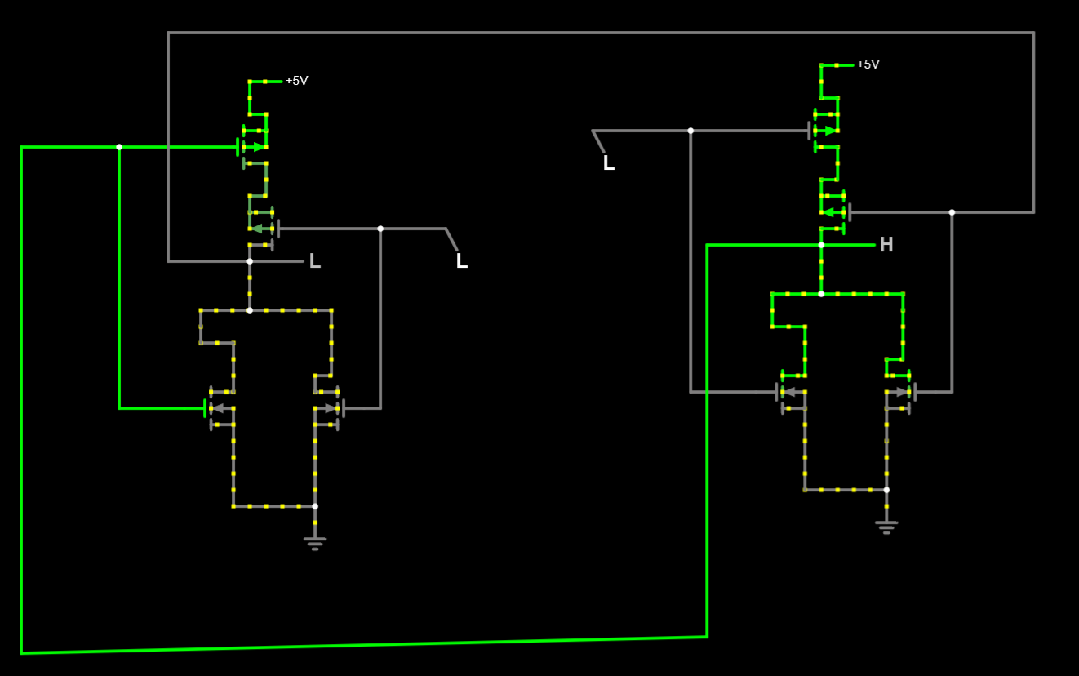
Case :
V1 lOW
V2 HIGH
OUTPUT1 LOW
OUTPUT2 LOW

Slide 66
BreadBoard

Slide 67
COST ANAYSIS

Slide 68
Wires = 13
Transistor IRF9530 = 26
Transistor IRF9540 = 36
 | SOLUTION A | SOLUTION B | SOLUTION C
TOTAL COSTS
TOTAL BENIFITS
COST BENEFIT RATIO
 | SOLUTION A | SOLUTION B | SOLUTION C
TOTAL COSTS
TOTAL BENIFITS
COST BENEFIT RATIO
 | SOLUTION A | SOLUTION B | SOLUTION C
TOTAL COSTS | 62 | 66 | 500
TOTAL BENIFITS | 440 | 441 | 0
COST BENEFIT RATIO | 7.09 | 6.68 | 0
Solution B uses more nodes on breadboard, hence more wires
Solution C is buying a ready SR Latch IC

Slide 69
SIMULATION

Slide 70
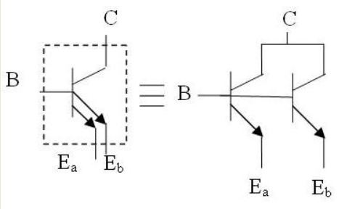
Multiple Emmiter transistor is equivelant to this form:

Slide 71

SR Latch using TTL
NAND Gate using TTL
Case :
V1 HIGH
V2 HIGH
OUTPUT LOW

Slide 72

Case :
V1 HIGH
V2 LOW
OUTPUT HIGH

Slide 73

Case :
V1 LOW
V2 HIGH
OUTPUT HIGH

Slide 74

Case :
V1 LOW
V2 LOW
OUTPUT HIGH

Slide 75

SR Latch using TTL:
Case :
V1 LOW
V2 LOW
OUTPUT1 HIGH
OUTPUT2 HIGH

Slide 76

Case :
V1 high
V2 LOW
OUTPUT1 LOW
OUTPUT2 HIGH

Slide 77

Case :
V1 LOW
V2 HIGH
OUTPUT1 HIGH
OUTPUT2 LOW

Slide 78

Case :
V1 HIGH
V2 HIGH
OUTPUT1 HIGH
OUTPUT2 LOW

Slide 79
SIMULATION

Slide 80
BreadBoard

Slide 81


Slide 82
COST ANAYSIS

Slide 83

SR Latch using ECL
NOR Gate using ECL
Case :
V1 LOW
V2 HIGH
OUTPUT LOW

Slide 84

Case :
V1 HIGH
V2 LOW
OUTPUT LOW

Slide 85

Case :
V1 LOW
V2 HIGH
OUTPUT LOW

Slide 86

Case :
V1 LOW
V2 LOW
OUTPUT HIGH

Slide 87

SR Latch using ECL:
Case :
V1 HIGH
V2 HIGH
OUTPUT1 LOW
OUTPUT2 LOW

Slide 88

Case :
V1 HIGH
V2 LOW
OUTPUT1 LOW
OUTPUT2 HIGH

Slide 89

Case :
V1 LOW
V2 HIGH
OUTPUT1 HIGH
OUTPUT2 LOW

Slide 90

Case :
V1 LOW
V2 LOW
OUTPUT1 HIGH
OUTPUT2 LOW

Slide 91
BreadBoard

Slide 92


Slide 93
COST ANAYSIS

Slide 94
Diode 1N4007 1A = 3.5
Wires = 9
Resistance = 3
Transistor 2N2222 =1.5
 | SOLUTION A | SOLUTION B | SOLUTION C
TOTAL COSTS | 71 | 76 | 500
TOTAL BENIFITS | 429 | 424 | 0
COST BENEFIT RATIO | 6.04 | 5.57 | 0
Solution B uses more nodes on breadboard, hence more wires
Solution C is buying a ready SR Latch IC

Slide 95
PCB LAYOUT

Slide 96

DTL Schematic used for PCB layout:

Slide 97

DTL PCB Layout:

